Slide 1
Neurofibromatosis Type 1
Laura Johnson

Slide 2
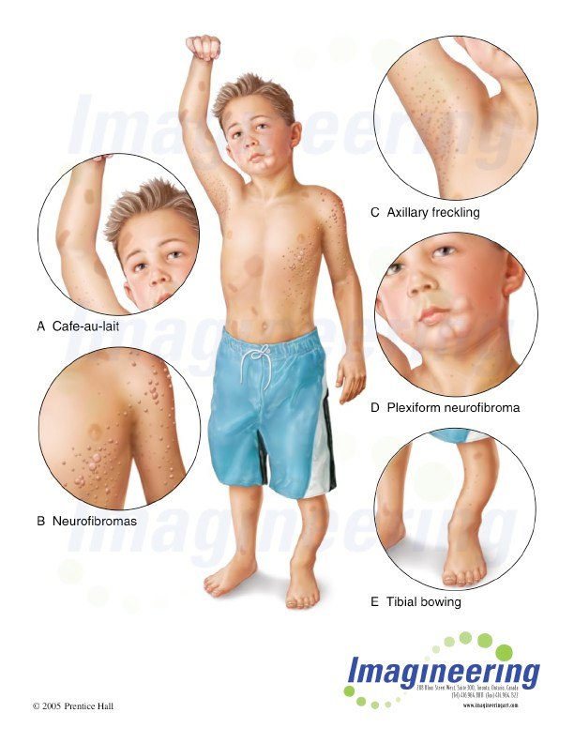
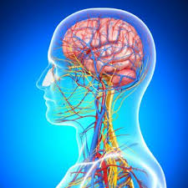
What is NF1?
1/3,000
17

Slide 3
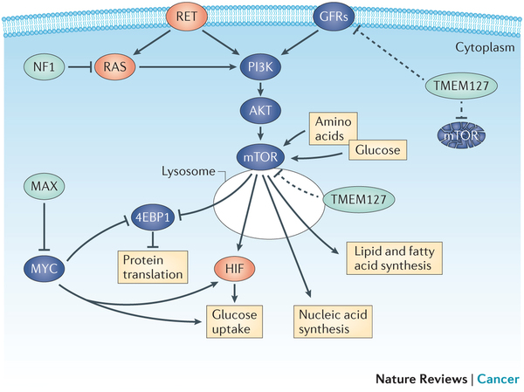
Neurofibromin
Human
0
RasGAP
Sec14
2839
Neurofibromin is a negative regulator of the Ras pathway, which regulates tumor growth and cell proliferation

Slide 4
How well is NF1 conserved?
Human
0
RasGAP
Sec14
2839
Chimp
0
RasGAP
Sec14
2839
100%
Mouse
0
RasGAP
Sec14
2841
98.5%
Zebrafish
0
RasGAP
2750
Sec14
88.4%
Fly
0
RasGAP
Sec14
2802
60.4%
Coiled Region

Slide 5
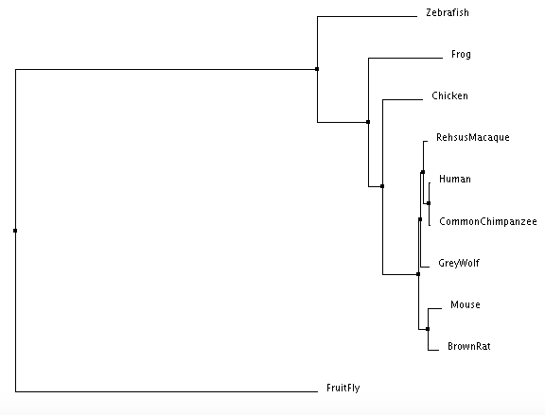
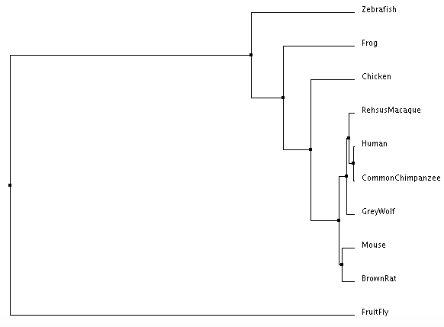
How well is neurofibromin conserved across species?
Neighbor Joining Tree
Average Distance Tree

